Slide 1
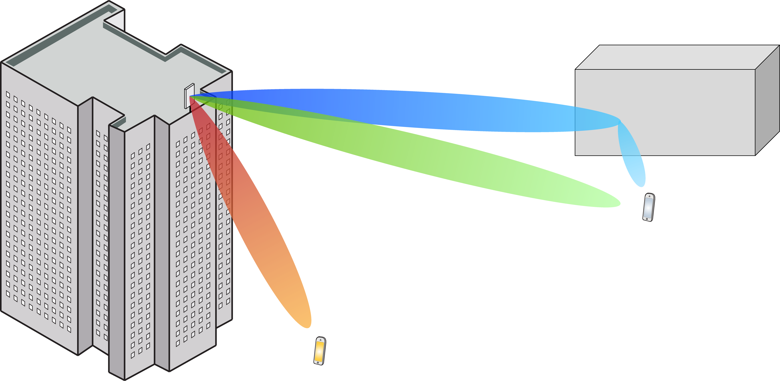
Multiple Antenna Communications
Lecture 2:
Basics of Transmit and Receive Beamforming
Emil Björnson

Slide 2
Outline
Recap of single-antenna channel capacity
Capacity of channels with multiple antennas at one side
Channel models for line-of-sight channels
Beamwidth with uniform linear arrays

Slide 3
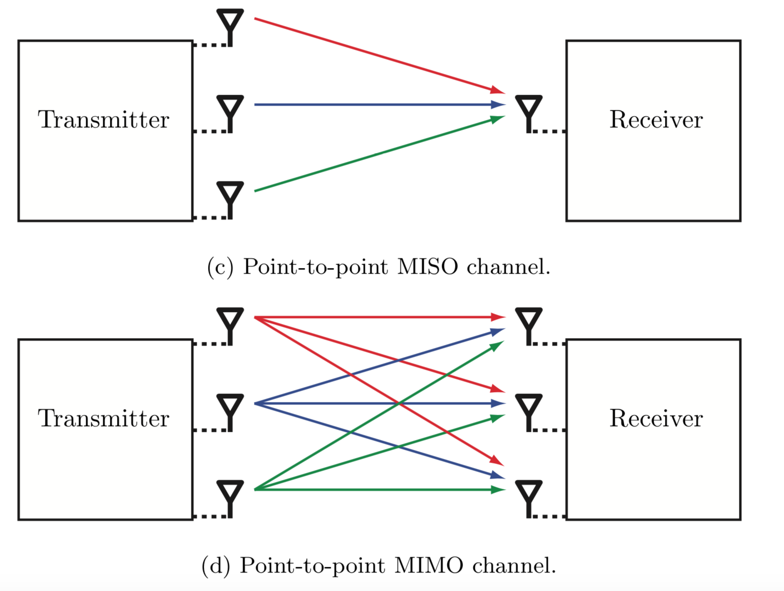
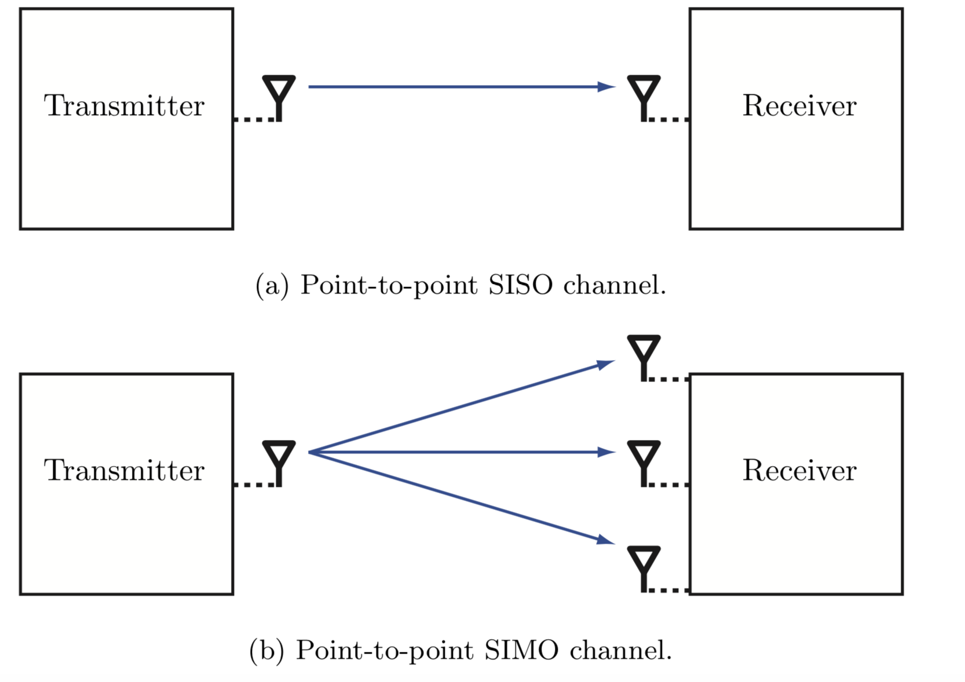
Taxonomy: Point-to-point channels
Single-input single-output (SISO)
Single-input multiple-output (SIMO)
Multiple-input single-output (MISO)
Multiple-input multiple-output (MIMO)

Slide 4
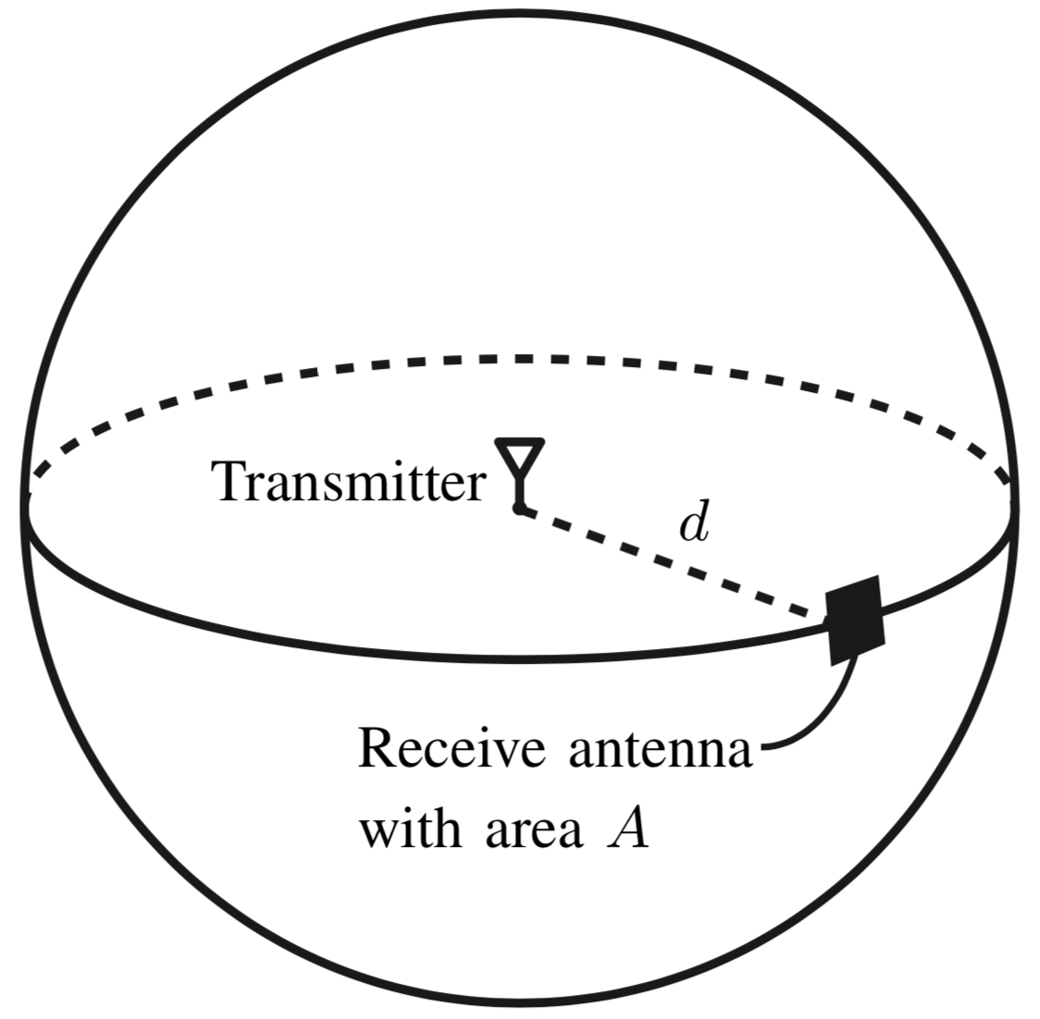

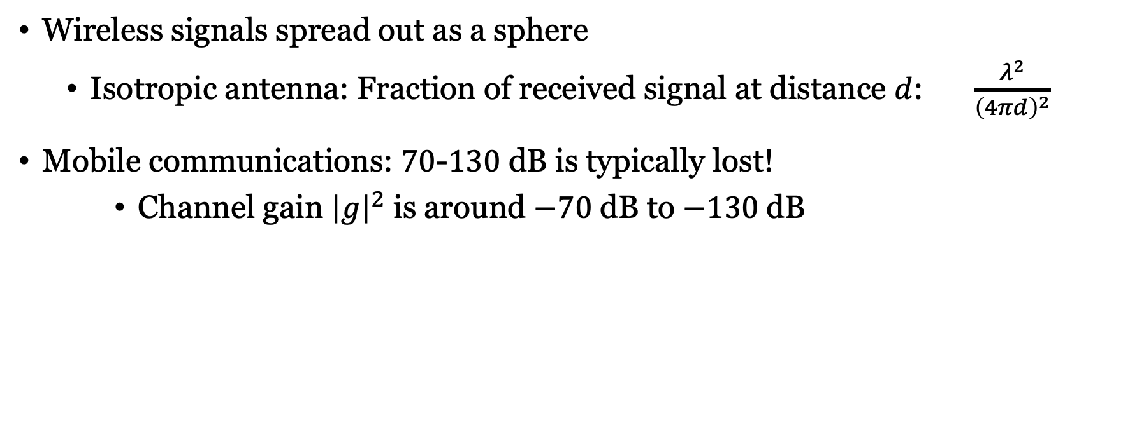
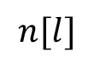
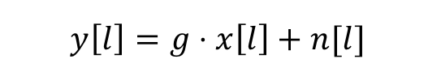
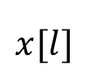
Not all transmit power is received
Wireless signals spread out as a sphere
Isotropic antenna: Fraction of received signal at distance $d$: $\frac{λ^{2}}{{\left(4πd\right)}^{2}}$
Mobile communications: $70$-$130$ dB is typically lost!
Channel gain ${\left|g\right|}^{2}$ is around $−70$ dB to $−130$dB
Also known as pathloss
$$n[l]$$
$$x[l]$$
$$g$$
+
$$y\left[l\right]=g⋅x\left[l\right]+n[l]$$
Channel response

Slide 5
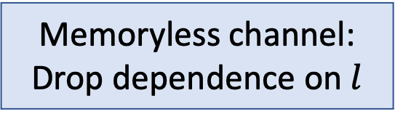
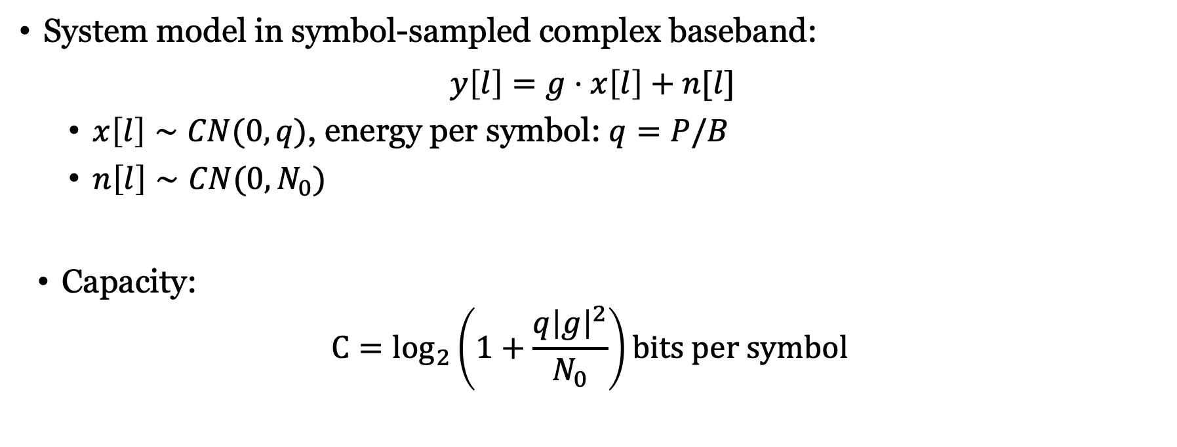
Capacity of memoryless SISO channel
System model in symbol-sampled complex baseband:
$$y\left[l\right]=g⋅x\left[l\right]+n[l]$$
$x\left[l\right]∼CN(0,q)$, energy per symbol: $q=P/B$
$n\left[l\right]∼CN(0,N_{0})$
Capacity:
$${C=log}_{2}\left(1+\frac{q{\left|g\right|}^{2}}{N_{0}}\right)bits per symbol$$
Memoryless channel: Drop dependence on $l$
Received SNR
How can we increase the SNR?

Slide 6
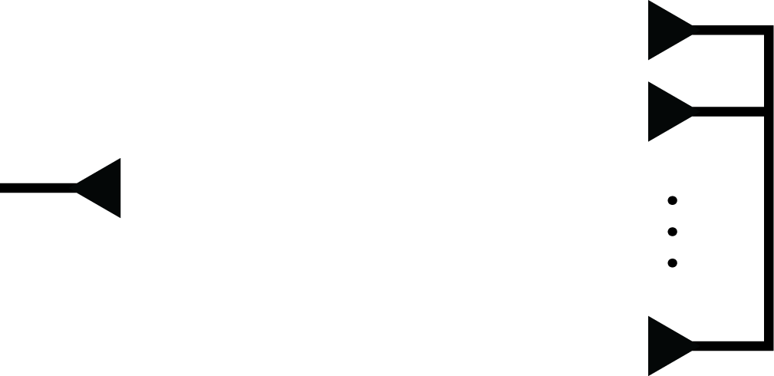
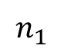
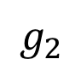
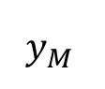
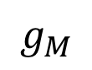
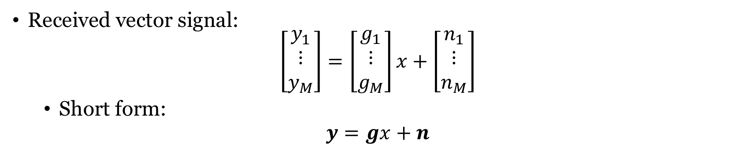
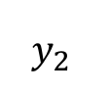
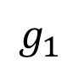
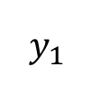
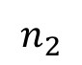
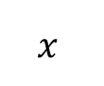
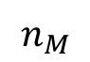
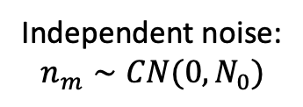
Single-input multiple-output (SIMO) channel
$$n_{1}$$
$$y_{1}$$
+
$$y_{2}$$
$$g_{1}$$
$$x$$
$$g_{2}$$
+
Independent noise:
$$n_{m}∼CN(0,N_{0})$$
$$g_{M}$$
$$n_{2}$$
+
$$y_{M}$$
$$n_{M}$$
Received vector signal:
$$\left[\begin{matrix}y_{1} \\ ⋮ \\ y_{M}\end{matrix}\right]=\left[\begin{matrix}g_{1} \\ ⋮ \\ g_{M}\end{matrix}\right]x+\left[\begin{matrix}n_{1} \\ ⋮ \\ n_{M}\end{matrix}\right]$$
Short form:
$$y=gx+n$$

Slide 7
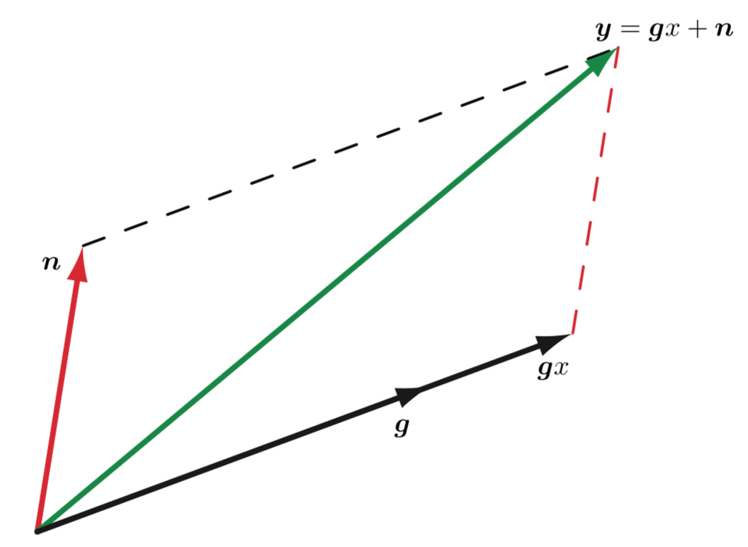
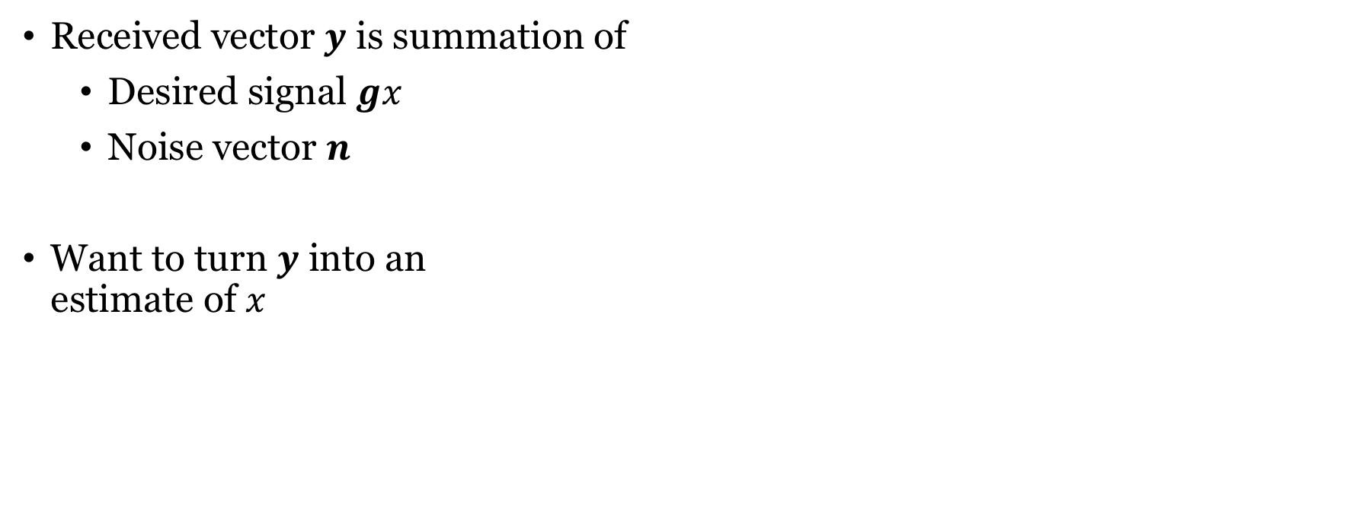
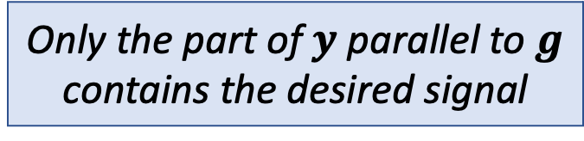
Geometry of received signal
Received vector $y$ is summation of
Desired signal $gx$
Noise vector $n$
Want to turn $y$ into an estimate of $x$
Only the part of $y$ parallel to $g$ contains the desired signal

Slide 8
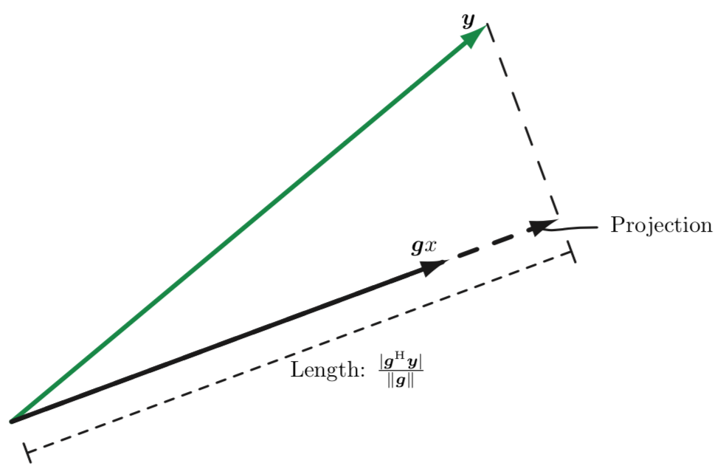
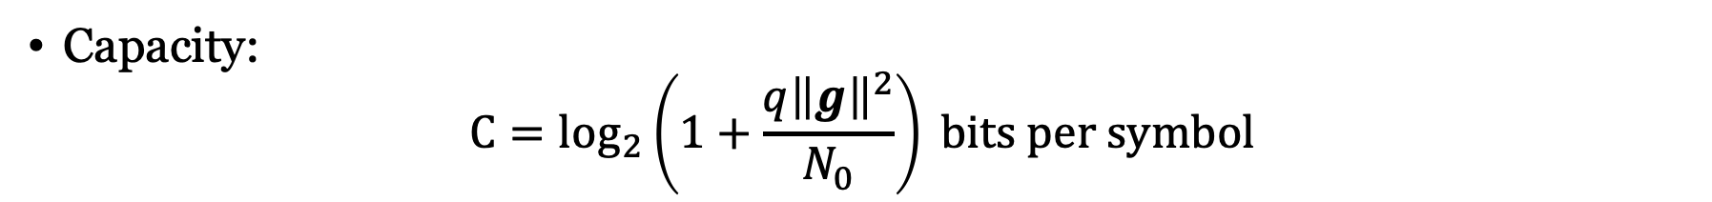
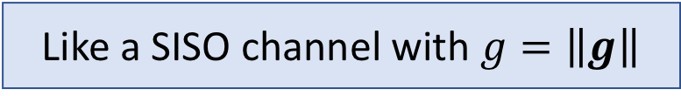
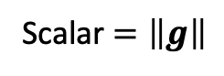
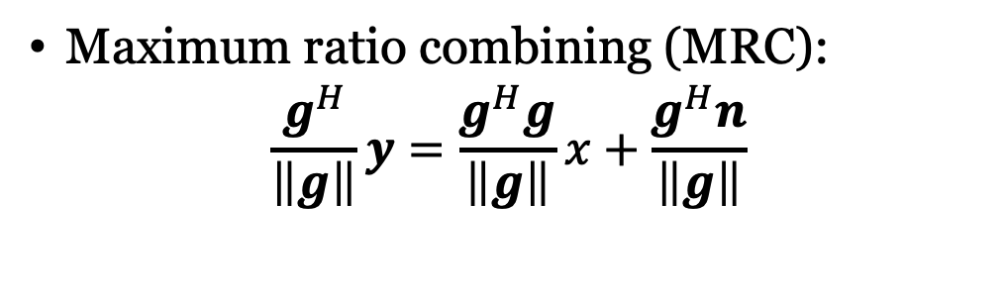
Capacity of SIMO channel
Maximum ratio combining (MRC):
$$\frac{g^{H}}{\left\|g\right\|}y=\frac{g^{H}g}{\left\|g\right\|}x+\frac{g^{H}n}{\left\|g\right\|}$$
Combining vector
Scalar $=\left\|g\right\|$
Like a SISO channel with $g=\left\|g\right\|$
Capacity:
$${C=log}_{2}\left(1+\frac{q{\left\|g\right\|}^{2}}{N_{0}}\right) bits per symbol$$

Slide 9
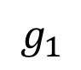
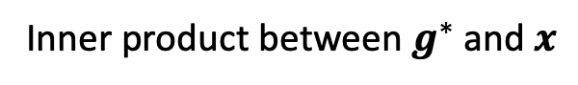
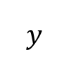
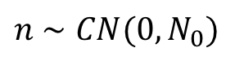
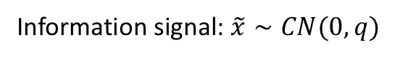
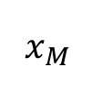
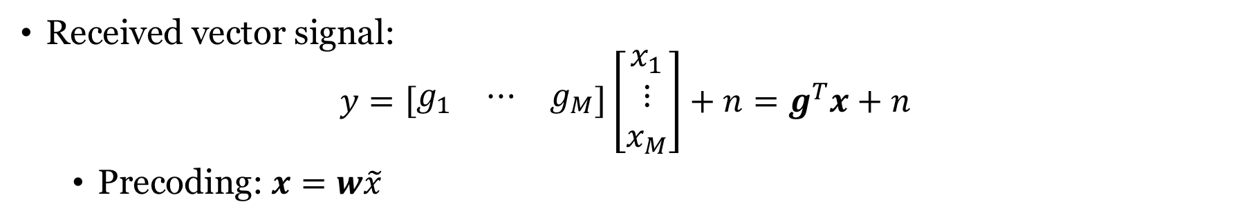
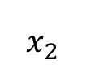
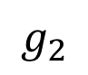
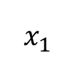
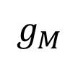
Multiple-input single-output (MISO) channel
$$x_{1}$$
$$g_{1}$$
$n$ $∼CN(0,N_{0})$
$$x_{2}$$
$$g_{2}$$
$$y$$
+
$$x_{M}$$
$$g_{M}$$
Inner product between $g^{∗}$ and $x$
Received vector signal:
$$y=\left[\begin{matrix}g_{1} & ⋯ & g_{M}\end{matrix}\right]\left[\begin{matrix}x_{1} \\ ⋮ \\ x_{M}\end{matrix}\right]+n=g^{T}x+n$$
Precoding: $x=w\tilde{x}$
Information signal: $\tilde{x}∼CN(0,q)$
Unit-norm
precoding vector

Slide 10
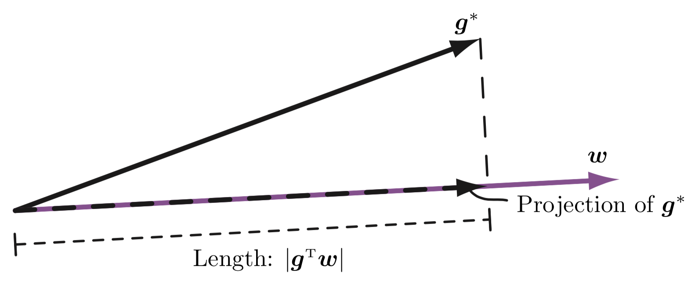
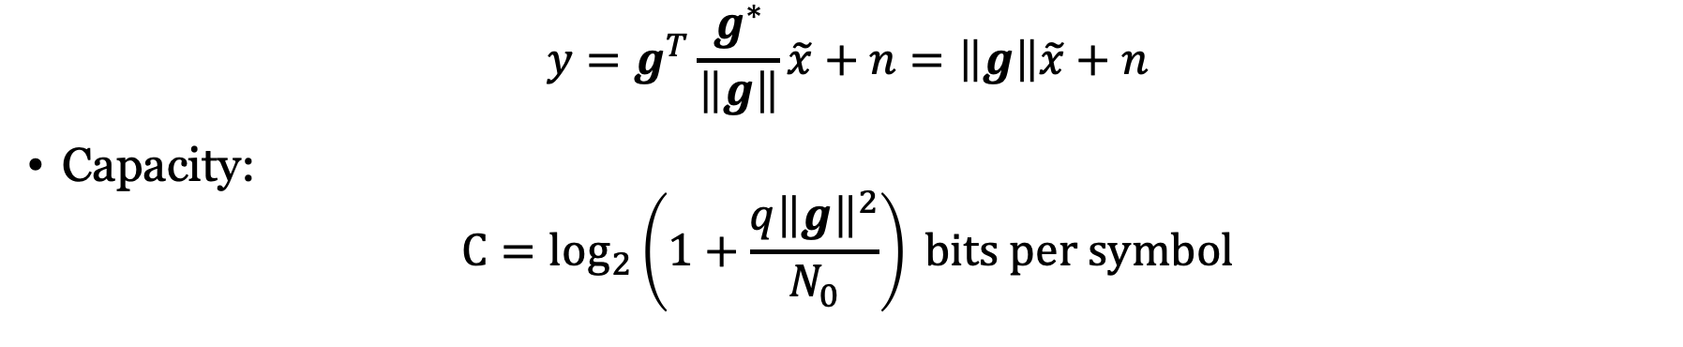
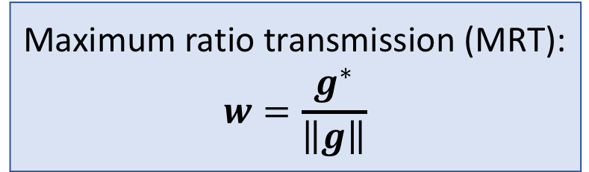
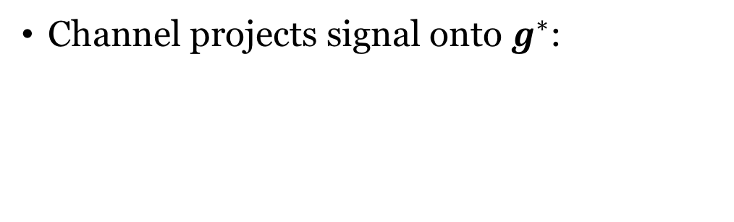
Geometry of received signal
Channel projects signal onto $g^{∗}$:
Maximum ratio transmission (MRT):
$$w=\frac{g^{∗}}{\left\|g\right\|}$$
$$y=g^{T}\frac{g^{∗}}{\left\|g\right\|}\tilde{x}+n=\left\|g\right\|\tilde{x}+n$$
Capacity:
$${C=log}_{2}\left(1+\frac{q{\left\|g\right\|}^{2}}{N_{0}}\right) bits per symbol$$

Slide 11
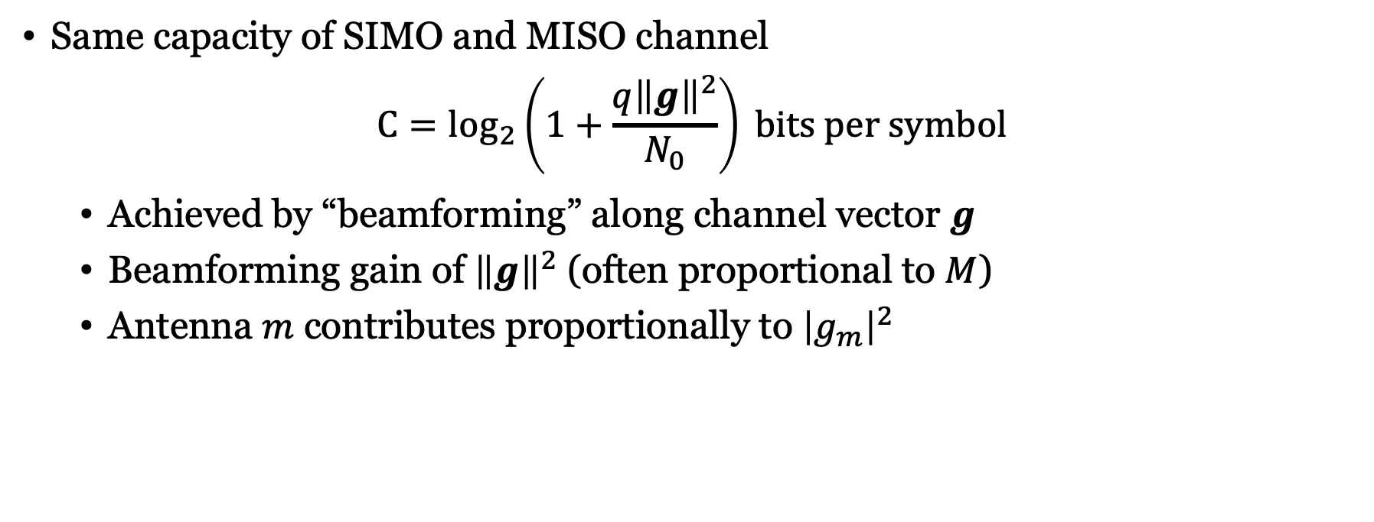
Receive and transmit beamforming
Same capacity of SIMO and MISO channel
$${C=log}_{2}\left(1+\frac{q{\left\|g\right\|}^{2}}{N_{0}}\right) bits per symbol$$
Achieved by “beamforming” along channel vector $g$
Beamforming gain of ${\left\|g\right\|}^{2}$ (often proportional to $M$)
Antenna $m$ contributes proportionally to ${\left|g_{m}\right|}^{2}$
Several different names
Maximum ratio combining/transmission (MRC, MRT)
Conjugate beamforming, matched filtering

Slide 12
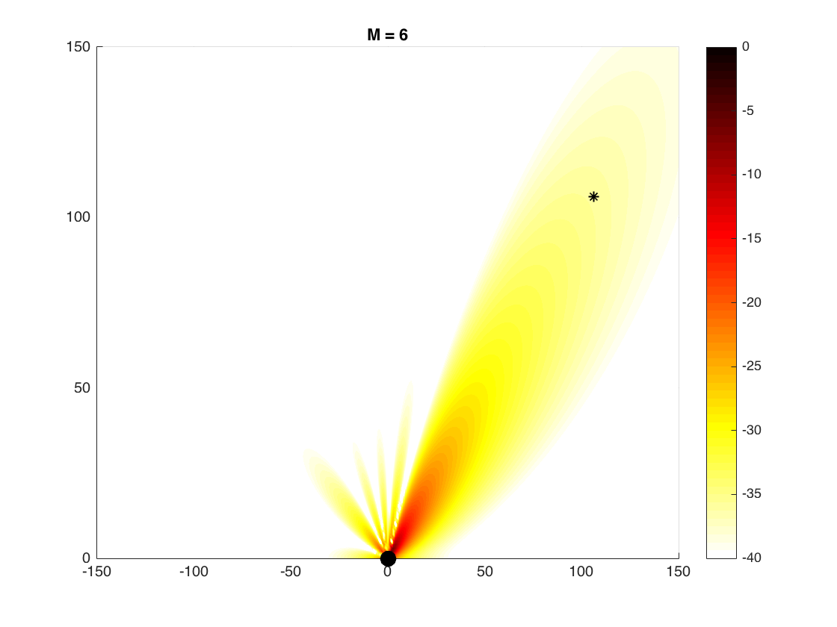
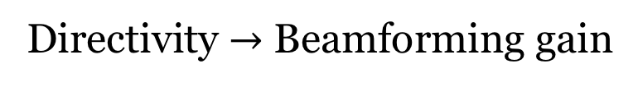
Transmit beamforming
Directivity $→$ Beamforming gain
Other names:
Array gain
Power gain
This is a valid interpretation only for line-of-sight channels

Slide 13
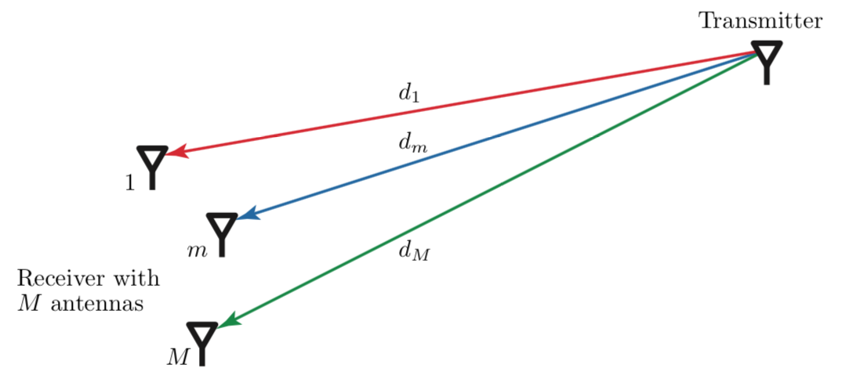
Free-space line-of-sight commmunication
Direct path between transmitter and receiver
No other paths
We will derive a channel model

Slide 14




Complex-baseband model for antenna $m$
Propagation delay: $τ_{m}=\frac{d_{m}}{c}$
Impulse response in passband: $h_{p,m}\left(t\right)=α_{m}δ\left(t+η−τ_{m}\right)$
Amplitude loss:
$$\frac{λ}{4πd_{m}}$$
Synchronization
$$d_{m}$$
Equivalent in complex baseband: $h_{m}\left(t\right)=α_{m}e^{−j2πf_{c}t}δ\left(t+η−τ_{m}\right)$
Symbol-sampled system model:
$$y_{m}\left[l\right]=\sum_{k}{x\left[k\right]}α_{m}e^{−j2πf_{c}\left(\frac{d_{m}}{c}−η\right)}sinc\left(l−k+B\left(η−\frac{d_{m}}{c}\right)\right)+n[l]$$
$=x\left[l\right]α_{m}+n[l]$ for $η=\frac{d_{m}}{c}$

Slide 15


Same sampling time at all receive antennas
Received at antenna $m$:
$$y_{m}\left[l\right]=\sum_{k}{x\left[k\right]}α_{m}e^{−j2πf_{c}\left(\frac{d_{m}}{c}−η\right)}sinc\left(l−k+B\left(η−\frac{d_{m}}{c}\right)\right)+n[l]$$
Use antenna $1$ as reference, $η=\frac{d_{1}}{c}$, and use $λ=\frac{c}{f_{c}}$:
$$y_{m}\left[l\right]=\sum_{k}{x\left[k\right]}α_{m}e^{−j2π\left(\frac{d_{m}−d_{1}}{λ}\right)}sinc\left(l−k+B\left(\frac{d_{1}−d_{m}}{c}\right)\right)+n[l]$$
Narrowband assumption: $B\frac{d_{m}}{c}$ roughly the same for all antennas
$$≈x\left[l\right]α_{m}e^{−j2π\left(\frac{d_{m}−d_{1}}{λ}\right)}+n[l]$$
Channel model: $g=\left[\begin{matrix}α_{1} \\ ⋮ \\ α_{M}e^{−j2π\left(\frac{d_{M}−d_{1}}{λ}\right)}\end{matrix}\right]$

Slide 16


Uniform linear array (ULA)
Antenna spacing: $Δ$
Angle of arrival: $φ$

Slide 17




Near-Field and Far-Field of an Antenna
$π/8$ phase difference
Length difference: $d^{′}−d=\sqrt{d^{2}+{\left(\frac{a}{2}\right)}^{2}}−d≈\frac{a^{2}}{8d}$
At most $π/8$ phase diff: $\frac{π}{8}≥\frac{2π}{λ}\frac{a^{2}}{8d} →d≥\frac{2a^{2}}{λ}$
Fraunhofer distance
Other electromagnetic near-field effects
Evanescent waves, Magnetic induction, …

Slide 18





Near-Field and Far-Field of an Array
$$b$$
Transmit antenna
$$d$$
$$a$$
Fraunhofer distance
Far-field of antenna: $d≥2a^{2}/λ$
Far-field of the array $d≥2b^{2}/λ$
Example: 3 GHz, $λ=0.1$ m
$b=10λ=1$ m: $\frac{2b^{2}}{λ}=20$ m
We are typically in the far-field!

Slide 19




Far-field approximation with ULA
Distances $d_{1},…,d_{M}$ approximately the same
Approximately same channel gain:
$$\frac{λ^{2}}{{\left(4πd_{m}\right)}^{2}}≈\frac{λ^{2}}{{\left(4πd\right)}^{2}}$$
$$e^{−j2π\left(\frac{d_{m}−d_{1}}{λ}\right)}=e^{−j2π\frac{(m−1)Δ\sin\left(φ\right)}{λ}}$$

Slide 20

ULA channel model
$M$ antennas in receiver array
Angle of arrival $φ$
Wavelength $λ$
Distance $Δ$ between antennas
Distance $d$ to first antenna
Channel vector:
$$g=\frac{λ}{4πd}\left[\begin{matrix}\begin{matrix}1 \\ e^{−j2π\frac{Δ\sin\left(φ\right)}{λ}}\end{matrix} \\ \begin{matrix}⋮ \\ e^{−j2π\frac{\left(M−1\right)Δ\sin\left(φ\right)}{λ}}\end{matrix}\end{matrix}\right]$$
Applies to both SIMO and MISO channels

Slide 21


Channel capacity with line-of-sight channel
Recall:
$${C=log}_{2}\left(1+\frac{q{\left\|g\right\|}^{2}}{N_{0}}\right) bits per symbol$$
We have ${\left\|g\right\|}^{2}=βM$ where $β=\frac{λ^{2}}{{\left(4πd\right)}^{2}}$:
$${C=log}_{2}\left(1+\frac{qβM}{N_{0}}\right)$$
Beamforming gain: $M$

Slide 22



Illustrations of beamforming versus real beamforming
Question 1:
Is this an accurate illustration?
Question 2:
What does a ”beam” look like in non-line-of-sight channels?
Same total power
2x maximum gain
Same total power
4x maximum gain

Slide 23



Beamwidth
$$\frac{1}{M}{\left|{\left[\begin{matrix}\begin{matrix}1 \\ e^{−j2π\frac{Δ\sin\left(φ_{beam}\right)}{λ}}\end{matrix} \\ \begin{matrix}⋮ \\ e^{−j2π\frac{\left(M−1\right)Δ\sin\left(φ_{beam}\right)}{λ}}\end{matrix}\end{matrix}\right]}^{H}\left[\begin{matrix}\begin{matrix}1 \\ e^{−j2π\frac{Δ\sin\left(φ\right)}{λ}}\end{matrix} \\ \begin{matrix}⋮ \\ e^{−j2π\frac{\left(M−1\right)Δ\sin\left(φ\right)}{λ}}\end{matrix}\end{matrix}\right]\right|}^{2}$$
Beamforming gain in more than one direction
Example: $M=10, Δ=\frac{λ}{2},φ_{beam}=0$
First-null beamwidth:
$$≈\frac{4}{M}$$
More antennas:
Narrower beams

Slide 24

Two benefits of beamforming
Beamforming gain
Stronger signal at desired location
Narrower beam
Less interference at undesired locations

Slide 25

Summary
Same capacity of SIMO and MISO channels
Achieved by beamforming: maximum ratio combining/transmission
Line-of-sight channels
All antennas contribute equally
Phase-shifts depend on angles
Beamforming gain of $M$
Beamwidth shrinks as $1/M$

Slide 26
Multiple Antenna Communications
Lecture 2:
Basics of Transmit and Receive Beamforming
Emil Björnson

